Slide 1
Development of 2016 Alpha Version Activity Data
January 18, 2018
Alison Eyth
EPA Office of Air Quality Planning and Standards

Slide 2
Overall 2016 Development Plan
Alpha version: February, 2018
Composed using currently available components
2016 for onroad, nonroad, fires, biogenics
Use 2014NEIv2 for the rest of the sectors
For EGUs, mixing 2014NEIv2 annual with 2016 CEMS in SMOKE is problematic (annual/hourly interactions)
EPA may be able to provide 2016 EGU point based on 2014v1
Draft 2016 point inventory should be available in March
Beta version: Summer, 2018
Will incorporate state inputs for key sectors and updates from workgroups available by that time
2023 and 2028 projections by fall
2016v1 final platform: Winter, 2019
Include final set up & emissions for 2016, 2023, 2028

Slide 3
2014-16 Platform Release Plans
EPA is currently working on 2014NATAv2
Based on 2014NEIv2 – should be wrapped up this month
EPA is working on a 2015 modeling case
2015 for onroad, nonroad, biogenics, fires
2014NEIv2 for the rest of the U.S.
2013 for Canada, Interpolated data for Mexico
EPA has components of 2016 available
2016 for nonroad, biogenics, fires (draft)
2016 onroad emission factors compatible with 2014NEIv2 – plans for activity data discussed today
Goal: release emissions platform SMOKE INPUTS and scripts for ‘14, ‘15, and ‘16 in February
Processed AQM-ready emissions will not be available

Slide 4
2016 Platform Onroad Plans
February 2018: alpha version of onroad
2016 emission factors compatible with 2014 v2
Uses updated speeds, light-duty splits, fuels, temporal distn.
Age distributions consistent with 2014 (not projected)
2016 activity data to be quickly developed
April 2018
Receive any S/L desired changes to 2016 activity data and representative counties
Would anyone want to provide 2023 and 2028 activity data?
Summer 2018
Incorporate provided inputs into beta version*
Develop future year projections*
* pending available resources

Slide 5
Activity Data Needs for Onroad
On-roadway emissions
Exhaust, evaporative, evaporative permeation, refueling, brake and tire wear
Primary inputs: vehicle miles traveled (VMT), average speeds, speed profiles, and temperature (gridded, hourly)
Off-network emissions (i.e. parked vehicles)
Exhaust, evaporative, evaporative permeation, refueling
Evaporative fuel vapor venting: hot soak (immediately after a trip) and diurnal (vehicle parked for a long period)
Primary inputs: vehicle population (VPOP) and Temperature (gridded, hourly, daily min/max)
Hoteling:
Extended idle and auxiliary power units (APU) for combination long-haul trucks
Primary inputs: Hoteling hours and T (gridded, hourly)
Notes:
VMT and HOTELLING are temporalized, others aren’t

Slide 6
Onroad Emissions Preparation
Hourly Met. Data
from WRF*
Meteorological Preprocessor (Met4Moves)
MOVES
Temperature ranges,
rel. humidity
Run MOVES to get emission factors (EFs) for representative counties for each temperature and speed needed
Gridded met
EF tables
Use representative EFs with county/ grid-specific activity data and hourly meteorology to create emissions for all counties
Activity Data
SMOKE
* WRF = Weather Research and Forecasting model
AQ model-ready files

Slide 7
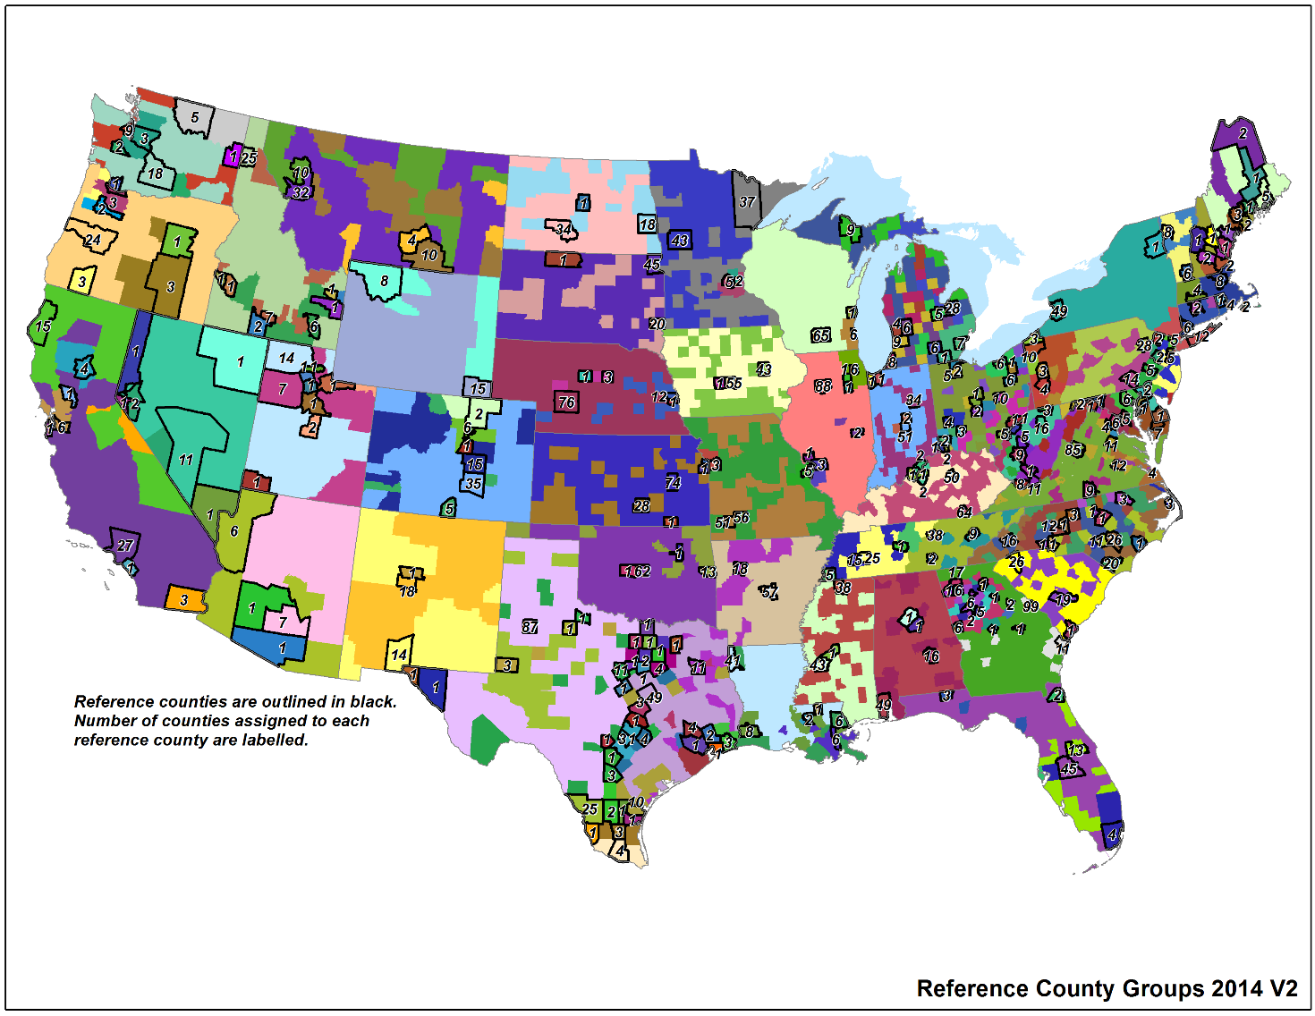
Representative Counties
3000+ US counties are mapped to 303 representative counties according to: state, fuels, age distribution, ramp fraction, inspection & maintenance (I/M) programs, and emissions standards
The criteria for
selecting rep.
counties was
discussed on
MJO in June, 2017
The selection
spreadsheet
will be available
with the v2
documentation
Notes:
Emphasize the county specific activity and the grid specific meteorology is used even if using rep counties.

Slide 8
Overview of VMT Development
Data used:
2014 NEI VMT
County-level VMT (VM2) from FHWA by road type
Use county population data to fill gaps in FHWA data
VMT by county and road type
County population data from U.S. Census
VMT by county, road type, and HPMS vehicle type
Allocate VMT by road type to HPMS vehicle types
FHWA fractions (VM4) vehicle type by road type
VMT by county, road type, and MOVES vehicle type
Distribute VMT to MOVES vehicle types
IHS 2014 vehicle populations
Distribute VMT to MOVES fuel types and road types
VMT by county, MOVES road type, vehicle type, and fuel type
IHS fuel fractions

Slide 9
New Data Available for 2016
Our preliminary 2016 VMT developed last summer used AEO 2017 to project to year 2016 by fuel and vehicle
Update: FHWA has recently released some of their data for 2016
https://www.fhwa.dot.gov/policyinformation/statistics/2016/
VM-2 data has vehicle miles traveled by state
Includes Urban/Rural and “Functional System” (i.e., road type)
FHWA provided county-specific VM-2 data to EPA

Slide 10
Creating 2016 VMT from 2014
The preferred approach for the alpha version is to adjust the 2014 VMT to 2016 levels
Retain splits by road type, vehicle type, fuel, etc.
EPA filled in missing data into county-level FHWA VM-2 data
Local roads and some minor collectors not provided
Computed magnitude from state totals and allocated to counties based on population
Converted from FHWA to MOVES road types
Computed 2014-2016 factors by county and road type, county overall, and county urban+rural
2016v2 onroad VMT projection factors.xlsx

Slide 11
Review of county-specific factors
The computed county-specific factors had much more spread that was anticipated for a two-year change
Expected change in 2 years was +/- 10%
Overall county factors varied from 0.46 to 2.74
Road type-specific factors even broader
593 county factors outside of +/- 10%
Some states had more “out of range” factors than others: TX had 142 counties, GA had 85, WI had 26, NC had 27, FL had 20, KS had 16, MI had 17, NM had 15, ND had 17, AR had 16, IN had 14
FHWA program is a similar to NEI in that state DOTs submit their VMT to DOT for collation
GA confirmed with their DOT that methods changed between 14 and 16 – others states may have also

Slide 12
State-specific factors
Due to the variability in the county-specific factors, state-road type and state-overall factors were also computed
Functional system-specific factors can be computed based on FHWA state VM-2 for 2014 and 2016
Overall state factors range from -1.4% (WY) to 14.1% (UT)
State-road type factors by functional system have more spread, but outliers tend to have little VMT in those road types
Factors by MOVES road type are next and in
state-road 2014-16 growth factors from VM-2.xlsx

Slide 13
AL to KS Factors
STATE | rural restricted | rural unrestricted | urban restricted | urban unrestricted | all rural | all urban | total
Alabama | 9.0% | 4.4% | 7.3% | 4.9% | 5.4% | 5.5% | 5.4%
Alaska | 11.5% | 10.7% | 4.4% | 7.0% | 11.0% | 6.3% | 8.3%
Arizona | 9.1% | -4.0% | 5.1% | 6.9% | 1.1% | 6.3% | 5.0%
Arkansas | 5.1% | 4.7% | 5.1% | 5.5% | 4.8% | 5.4% | 5.1%
California | 24.3% | -9.4% | 7.5% | -1.8% | 1.1% | 2.4% | 2.2%
Colorado | 10.3% | 4.0% | 8.2% | 5.7% | 6.0% | 6.7% | 6.5%
Connecticut | 1.3% | 1.3% | 2.1% | 0.8% | 1.3% | 1.4% | 1.4%
Delaware | 7.8% | 3.6% | 13.0% | 4.4% | 4.4% | 6.8% | 6.1%
Dist. of Columbia | N/A | N/A | 8.3% | 1.1% | N/A | 2.7% | 2.7%
Florida | 13.2% | 8.8% | 10.9% | 5.3% | 10.3% | 6.6% | 7.2%
Georgia | 10.2% | 18.7% | 6.4% | 9.0% | 16.4% | 8.2% | 10.1%
Hawaii | N/A | 6.1% | 7.6% | 2.9% | 6.1% | 4.2% | 4.5%
Idaho | 28.2% | -2.0% | 27.4% | 2.6% | 5.5% | 7.8% | 6.5%
Illinois | 7.5% | 1.3% | 7.3% | -0.4% | 3.4% | 2.0% | 2.3%
Indiana | 9.2% | 11.7% | 10.1% | -1.1% | 11.0% | 1.5% | 5.0%
Iowa | 5.4% | 6.4% | 3.4% | 6.9% | 6.2% | 6.1% | 6.1%
Kansas | 8.0% | -0.1% | 7.0% | 6.3% | 2.4% | 6.5% | 4.5%

Slide 14
KY to NY Factors
STATE | rural restricted | rural unrestricted | urban restricted | urban unrestricted | all rural | all urban | total
Kentucky | 6.8% | 0.1% | 4.0% | 2.9% | 2.5% | 3.3% | 2.9%
Louisiana | -1.2% | -7.4% | 14.6% | 3.5% | -5.5% | 7.1% | 1.9%
Maine | -7.7% | -1.7% | 42.4% | 14.5% | -3.0% | 21.2% | 3.8%
Maryland | 24.4% | -0.1% | 5.6% | 4.0% | 5.0% | 4.8% | 4.8%
Massachusetts | 36.3% | 32.5% | 6.4% | 6.0% | 33.8% | 6.2% | 7.4%
Michigan | 8.0% | 4.8% | 3.2% | -0.6% | 5.6% | 0.7% | 2.1%
Minnesota | 7.1% | 1.8% | 8.7% | -0.3% | 2.7% | 3.0% | 2.8%
Mississippi | 25.6% | -2.6% | 8.6% | 3.7% | 1.8% | 5.0% | 3.2%
Missouri | 10.0% | 1.7% | 4.3% | 4.1% | 4.7% | 4.2% | 4.4%
Montana | 2.9% | 3.5% | 11.6% | 3.1% | 3.3% | 4.3% | 3.6%
Nebraska | 4.7% | -3.1% | 14.5% | 13.9% | -0.6% | 14.0% | 5.5%
Nevada | 13.0% | 5.0% | 8.9% | 4.0% | 8.3% | 5.3% | 5.9%
New Hampsh. | 5.9% | 4.7% | 3.3% | 3.9% | 5.0% | 3.6% | 4.2%
New Jersey | 7.4% | 4.4% | 5.0% | 1.5% | 5.4% | 2.8% | 3.0%
New Mexico | 5.5% | 13.9% | 6.9% | 8.5% | 11.4% | 8.2% | 10.0%
New York | 5.6% | -26.4% | -2.8% | 1.6% | -19.9% | -0.1% | -4.9%

Slide 15
NC to WY factors
STATE | rural restricted | rural unrestricted | urban restricted | urban unrestricted | all rural | all urban | total
North Carolina | 8.6% | 7.2% | 9.4% | 7.9% | 7.5% | 8.4% | 8.1%
North Dakota | -4.5% | -15.2% | 7.6% | 9.6% | -12.9% | 9.3% | -7.3%
Ohio | 6.4% | 3.8% | 5.5% | 5.4% | 4.6% | 5.4% | 5.2%
Oklahoma | 9.5% | 3.2% | 6.6% | -1.2% | 4.7% | 1.2% | 2.8%
Oregon | 12.0% | 6.7% | 7.3% | 3.7% | 8.1% | 4.8% | 6.1%
Pennsylvania | -2.7% | -5.2% | 10.5% | 2.0% | -4.3% | 4.7% | 1.5%
Rhode Island | 27.8% | -9.1% | 8.9% | -0.8% | 3.3% | 3.3% | 3.3%
South Carolina | 12.3% | 8.4% | 11.0% | 8.1% | 9.7% | 8.9% | 9.3%
South Dakota | 27.5% | -7.1% | 1.1% | 3.2% | 3.2% | 2.6% | 3.1%
Tennessee | 4.4% | -6.8% | 13.6% | 10.4% | -3.3% | 11.5% | 6.3%
Texas | 14.7% | 1.8% | 14.5% | 14.0% | 4.8% | 14.2% | 11.6%
Utah | 13.4% | 13.5% | 13.1% | 15.1% | 13.5% | 14.4% | 14.1%
Vermont | 10.2% | 4.2% | 9.5% | -0.5% | 5.5% | 2.2% | 4.6%
Virginia | 0.4% | -7.5% | 21.4% | 3.2% | -4.9% | 9.8% | 4.3%
Washington | 8.8% | 5.6% | 6.0% | 3.4% | 6.9% | 4.4% | 5.1%
West Virginia | -17.6% | -8.3% | 20.3% | 20.4% | -10.7% | 20.3% | 2.2%
Wisconsin | 13.0% | 1.9% | 7.7% | 10.2% | 4.1% | 9.3% | 6.6%
Wyoming | 0.5% | -2.5% | -7.5% | -0.2% | -1.4% | -1.5% | -1.4%

Slide 16
Decision Point
What level of factors to use?
State+road type
State+urban, State+rural
State overall
State+restricted, State+unrestricted (not shown)
Pros/cons:
Using one factor per state is simpler for downstream computations of VPOP and for hoteling hours based on VMT [and for understanding how VMT was adjusted]
Using urban/rural factors allows for differences between urban and rural areas
Using the same factor for all road types does not characterize differences between the road types

Slide 17
2014NEIv2 Coming Soon
Data for 2014NEIv2 has been computed and should be posted with documentation by the end of January
Seeded CDBs for emission factor mode modeling
For representative counties only
Includes small numbers in key fields so emission factors are generated for all potential source and road types
Age distributions averaged across represented counties
Unseeded CDBs for inventory mode modeling
For all counties
Includes county-specific activity data (including holes where they exist)
Activity data in SMOKE format (VPOP, VMT, hoteling)
Scripts to put activity into and get it out of CDBs
Other files updated such as those listed in 2014v1 TSD

Slide 18
Modeling Platform for 2014v2
Package of scripts and ancillary data to run SMOKE-MOVES including rep. county and fuel mappings is currently available (courtesy UNC)
https://drive.google.com/drive/folders/1-UHPzfNS46fw1fjx0rOqzbC24s4-qoKr
2014 and 2015 emission factors are included
2016 will be added mid-February, including emissions for 14, 15, 16 in SMOKE Flat file format

Slide 19
Next Steps
Review representative counties for potential changes
Review 2016 data for issues, once it has been provided
Review issues brought up to the workgroup
Distribution of hoteling hours as compared to known truck stops
Best practices for developing heavy-duty VMT and VPOP
E.g., checks of VMT/vehicle
Best practices for using IHS data for splitting VMT and VPOP
Best source of age distributions for 2016 – especially for heavy-duty vehicles
Review workgroup charge here: https://drive.google.com/drive/u/0/folders/12UNpxNr8GlRDZmY3AKdEgm62qRy-vHCn

